Slide 1
Loser on Loser
Loser on loser play is a type of declarer play in bridge, usually in trump contracts, where the declarer discards a loser card (the one that is bound to be given up anyway) in a side suit on an opponent's winner, instead of ruffing. Functionally this substitutes one loser for another. If there is a real danger of being over-ruffed should you ruff consider this loser on loser play instead. It should not be confused with a hold up play in no trumps

Slide 2
Loser on Loser Play
Using a loser on loser play , you are effectively substituting a certain loser in another side suit for a probable/definite loser in the suit led
This is one way of conserving trumps or avoiding a trump promotion for defenders
Do not use this technique if you have no losers in the other side suit

Slide 3
Loser on Loser
Consider this hand in 4♠ after East opens a weak 2♥, On the lead 3rd ♥lead from E, if you ruff low, you maybe over-ruffed and still have a ♣loser. So instead of ruffing dump the ♣5 and the take the next 10 tricks. You know that E holds 6 cards in ♥

Slide 4
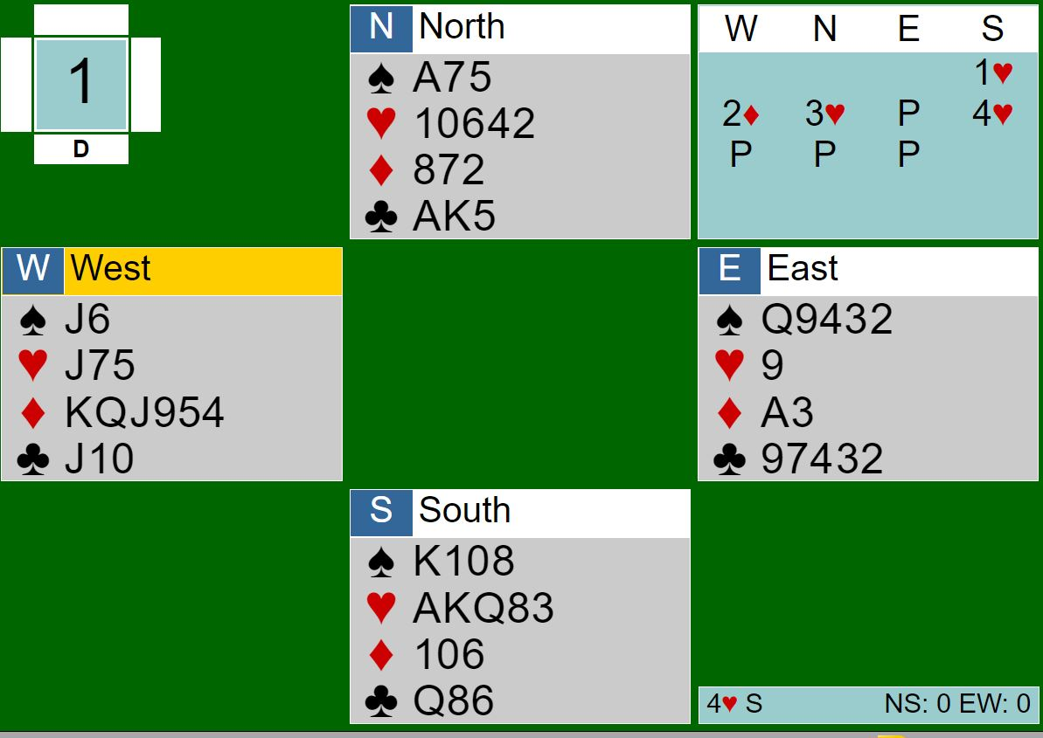
Loser on Loser Play
Contract 4♥
The lead is ♦K , which is overtaken by E and the suit returned. West then plays a 3rd ^{rd} round. E being very aware ruffs with 9 ♥. If you over-ruff you go down, losing to ♥J. Instead discard a ♠ , win any return and draw trumps for the contract

Slide 5
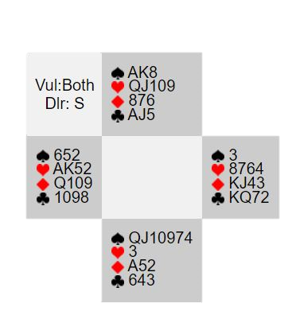
Loser on Loser Play
The contract is 4♠ after S opens a weak 2♠ . West leads ♥A, and then switches to ♣10. Do not cover with the ♣J but win with the A. . Play ♠4 to A and lead ♥Q and discard ♣4. Win any return, and play trumps to dummy and discard losers on the ♥J10

Slide 6
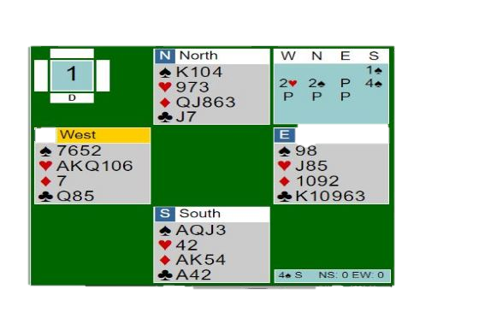
Loser on Loser
The contract is 4♠ despite the 4-3 fit, and W leads ♥A and continues them. On the 3rd ♥ if you ruff you are down. Instead discard a ♣ . Now declarer can safely draw trumps, and the long ♦ will remove the other ♣ loser

Slide 7
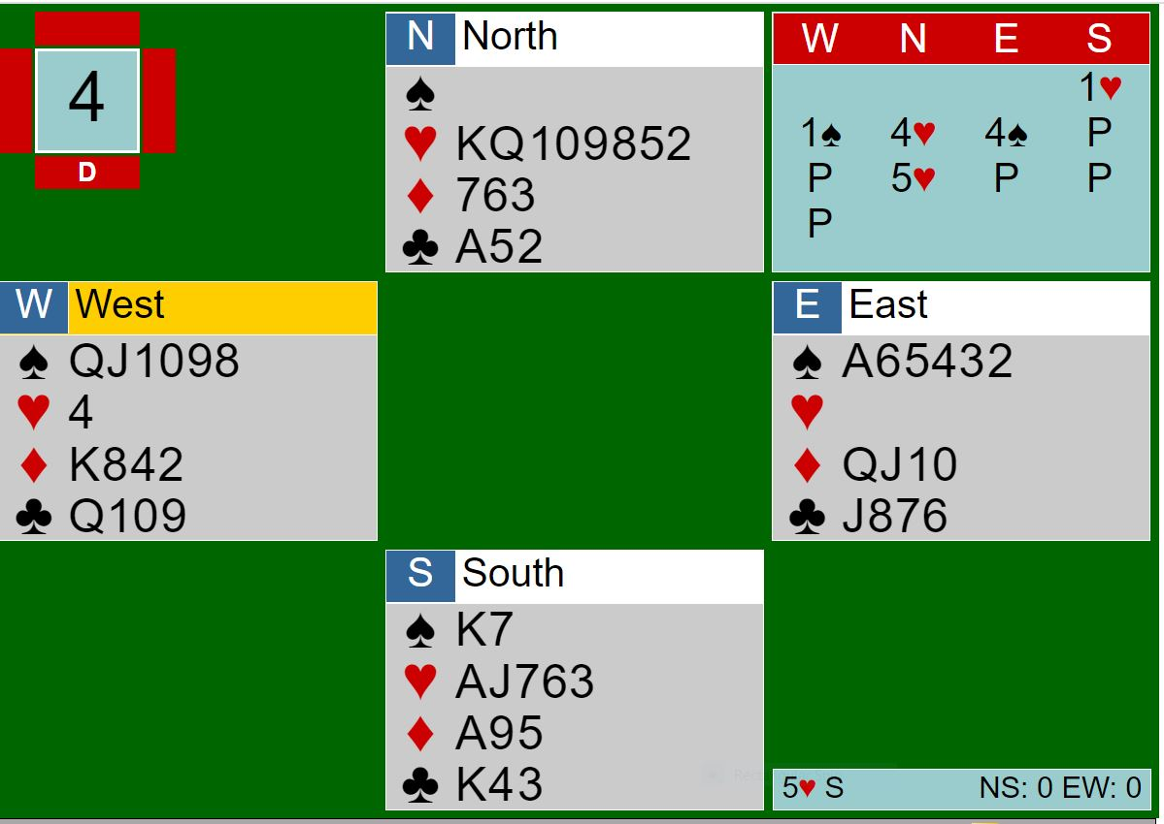
Loser on Loser Play
The contract is 5♥ by South
The ♠Q is led and you are tempted to ruff in dummy. If you do so you go down. Instead discard ♦3 and let the defence have the A. Win any return, draw trumps and on ♠K discard ♦ 6. You now lose a♣ but made 11 tricks

Slide 8
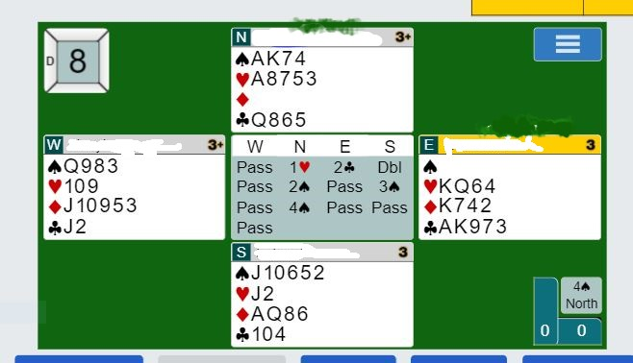
Loser on Loser
Contract 4♠ by N. The lead is ♣A, K, followed by a 3rd ♣. Ruffing is fatal as W can overruff and play a ♥. Instead discard the ♥2 and let W ruff. Win the ♥return with♥ A , and now ruff a♥ in dummy. Lead ♦ A and discard a♥ and lead 3 rounds of ♠ (from the J). finessing the ♠Q. Now lead ♣Q, and ruff out 2 losing ♥in dummy. When it was played , no loser on loser play so went 2 down

